Slide 1
Divide and Conquer
CSE 2201: Algorithm Analysis and Design
Md Mehrab Hossain Opi

Slide 2
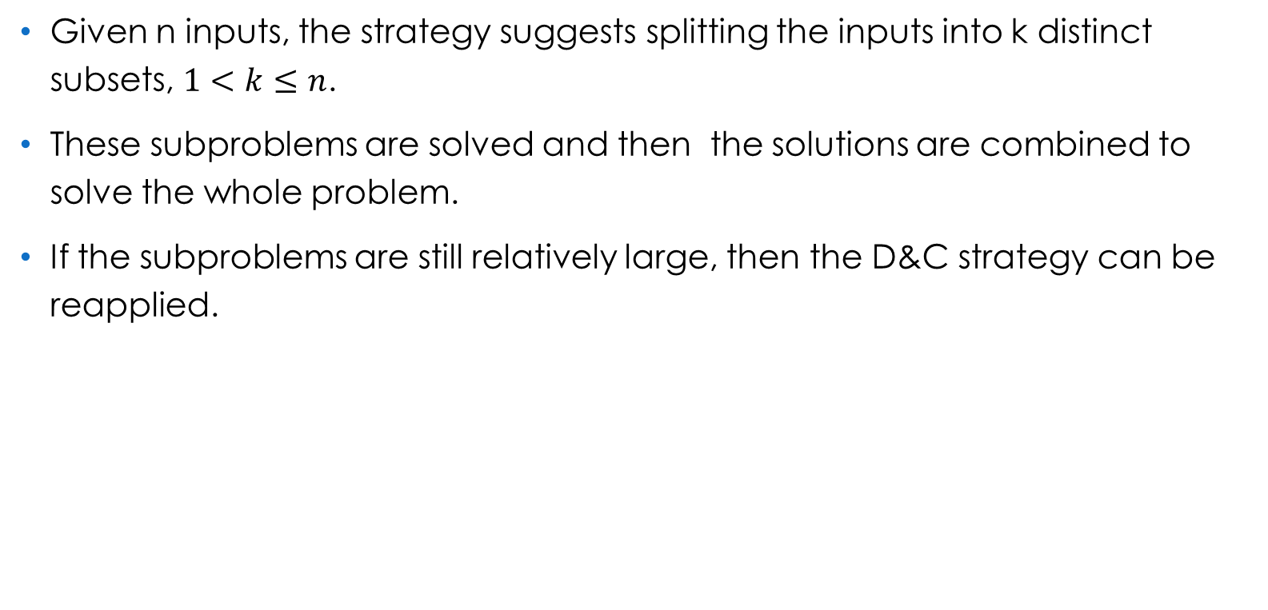
General Method

Slide 3
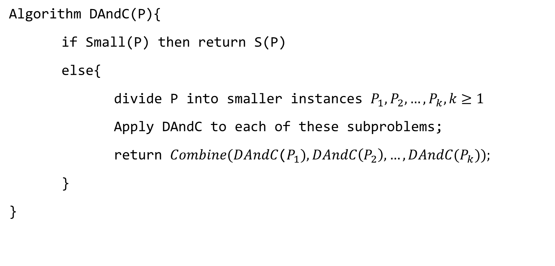
Control Abstraction for D&C

Slide 4
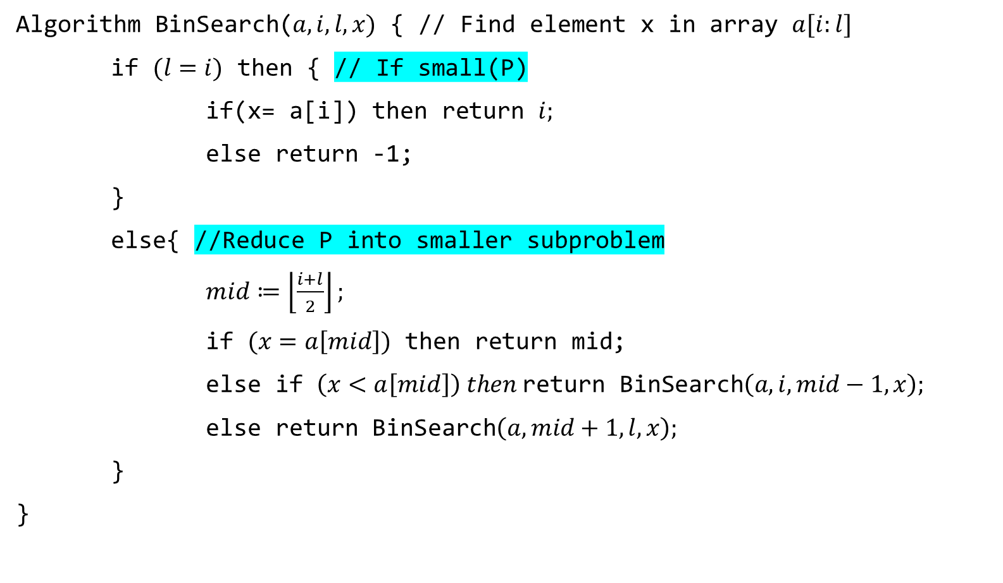
Binary Search

Slide 5
Sorting Algorithms
Merge Sort
Quick Sort
Refer to the slides of previous semester.

Slide 6
Selection Problem
Given an array of size n, we need to determine the k’th smallest element.
Can be solved using the partition function of quick sort.
We can use different partition method to improve the worst-case complexity.

Slide 7
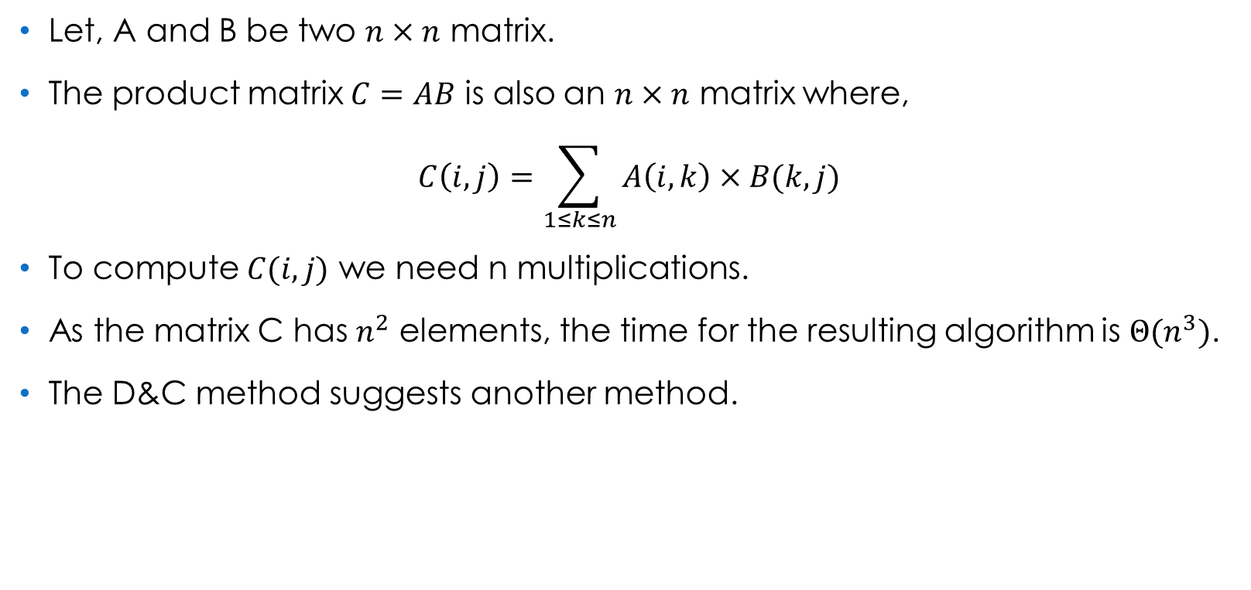
Strassen’s Matrix Multiplication

Slide 8
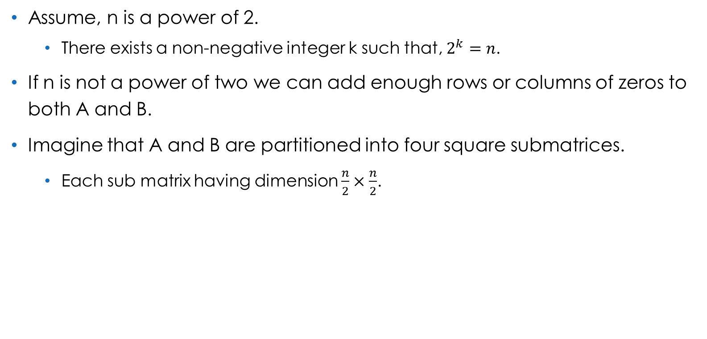
Strassen’s Matrix Multiplication

Slide 9
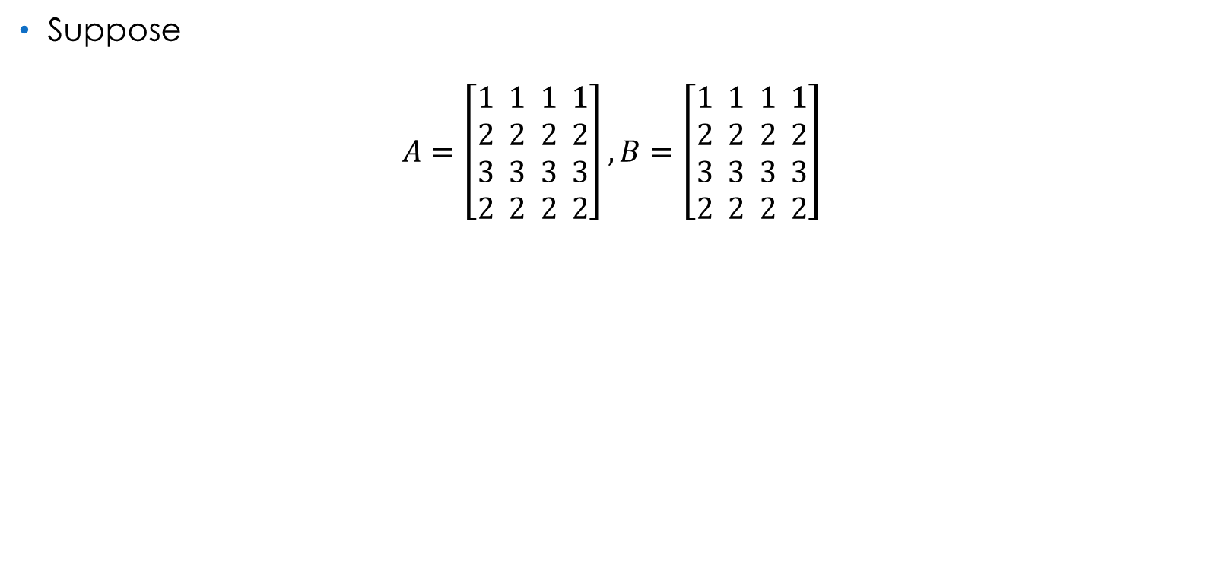








Strassen’s Matrix Multiplication

Slide 10
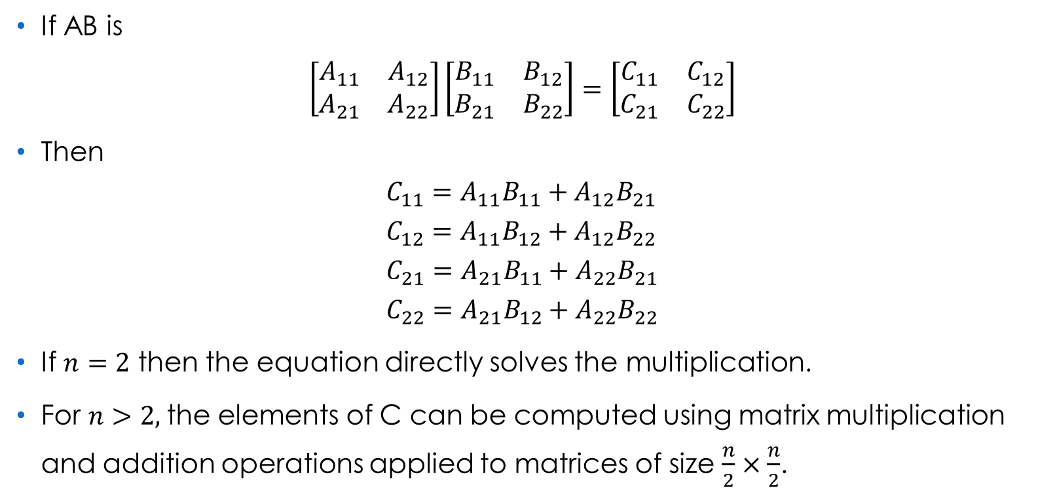
Strassen’s Matrix Multiplication

Slide 11
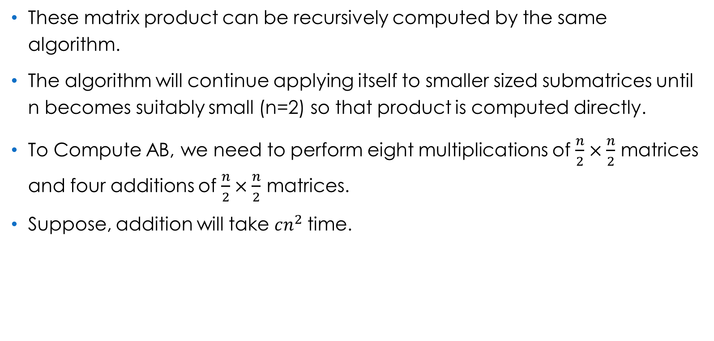
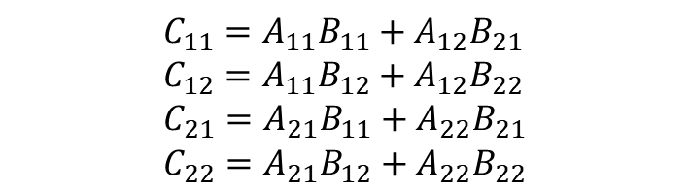
Strassen’s Matrix Multiplication

Slide 12
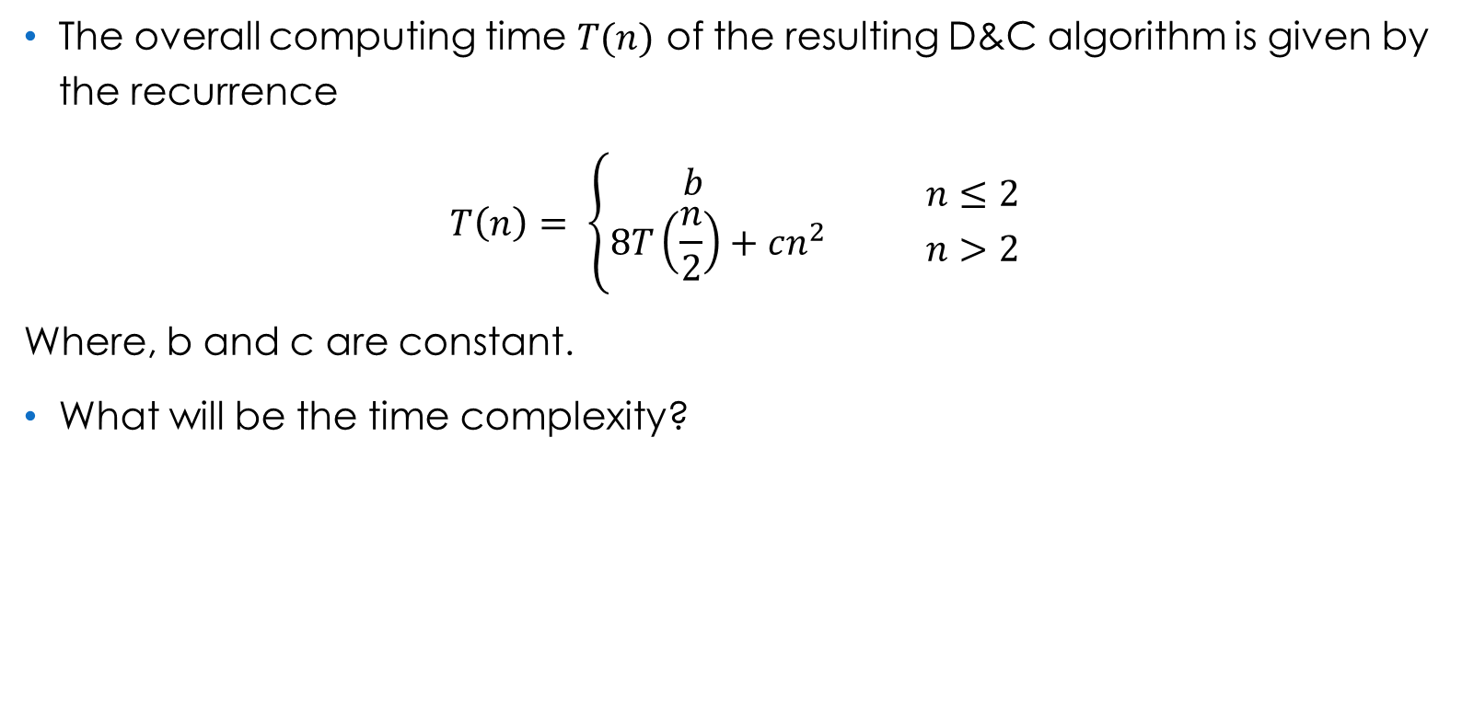
Strassen’s Matrix Multiplication

Slide 13
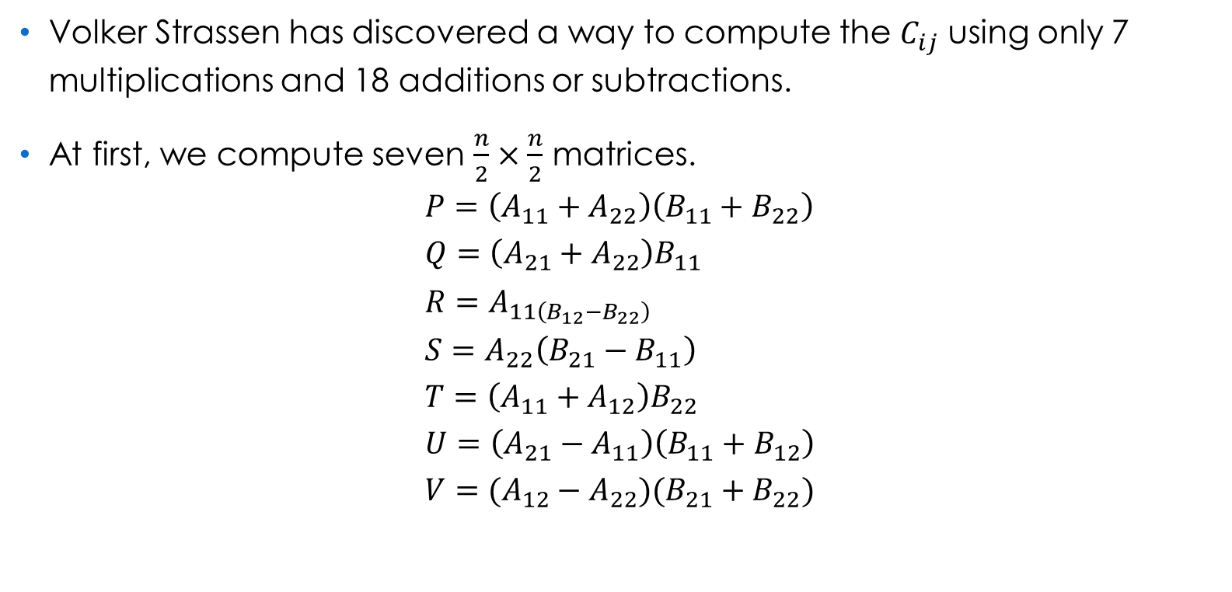
Strassen’s Matrix Multiplication

Slide 14
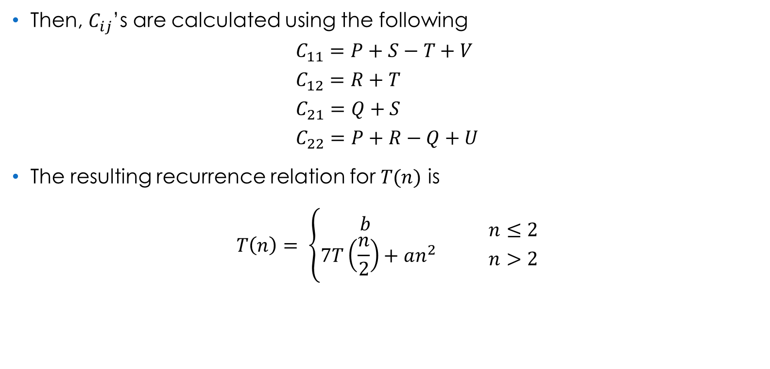
Strassen’s Matrix Multiplication

Slide 15
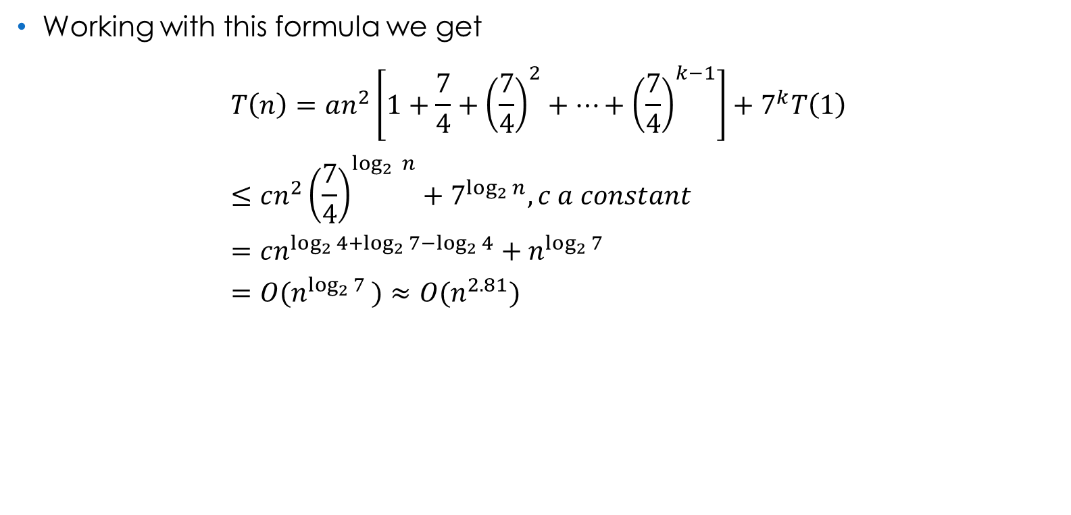
Strassen’s Matrix Multiplication

Slide 16
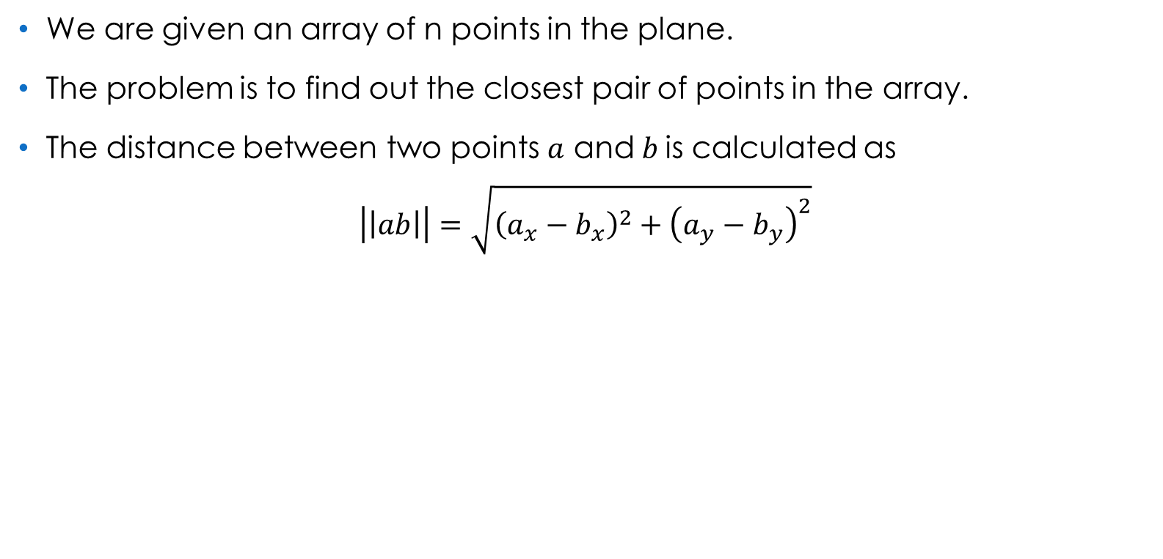
Closest Pair of Points

Slide 17
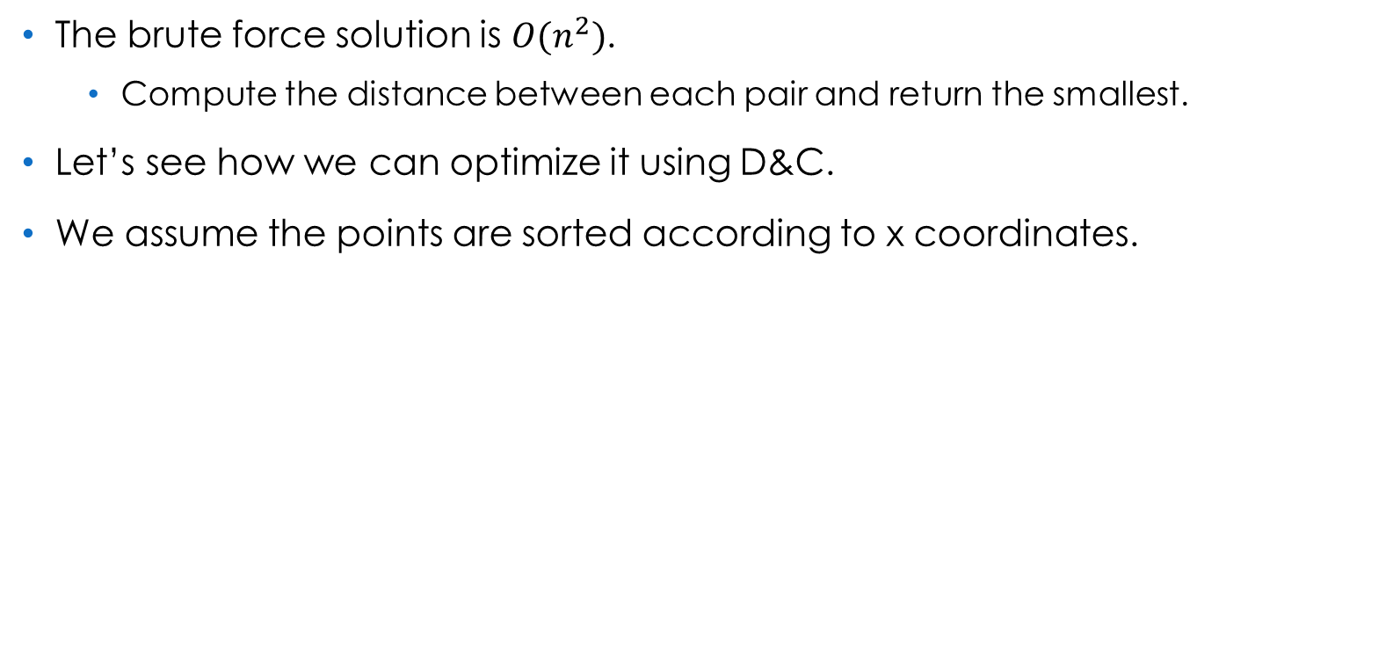
Closest Pair of Points

Slide 18
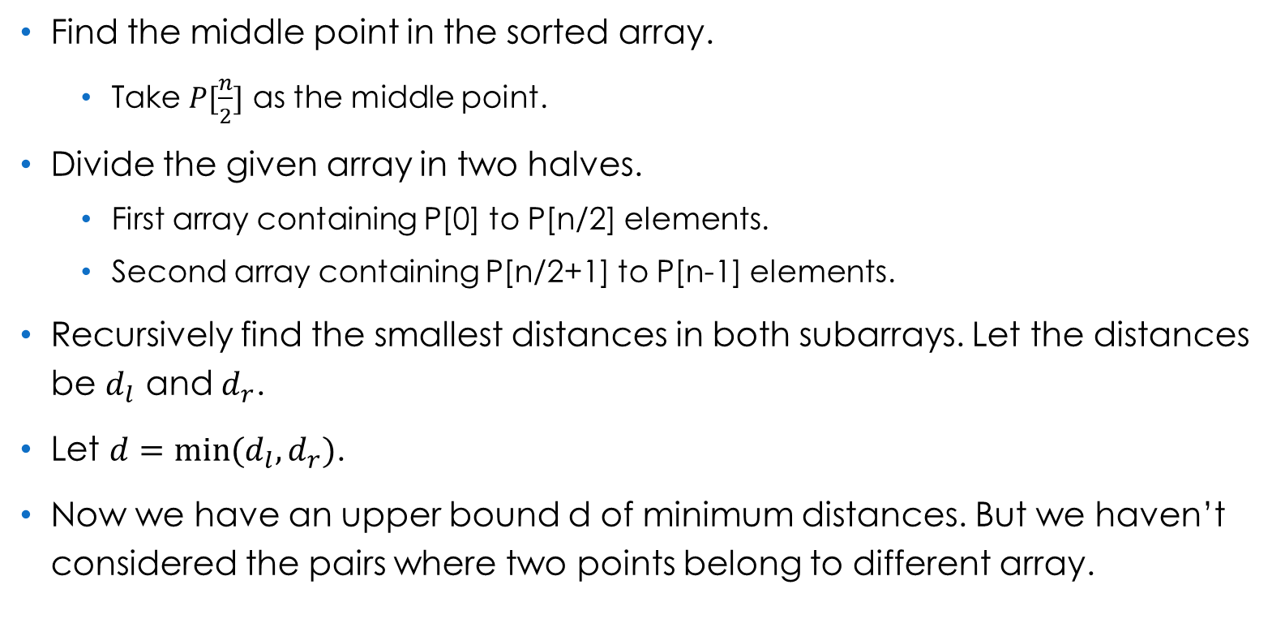
Closest Pair of Points

Slide 19
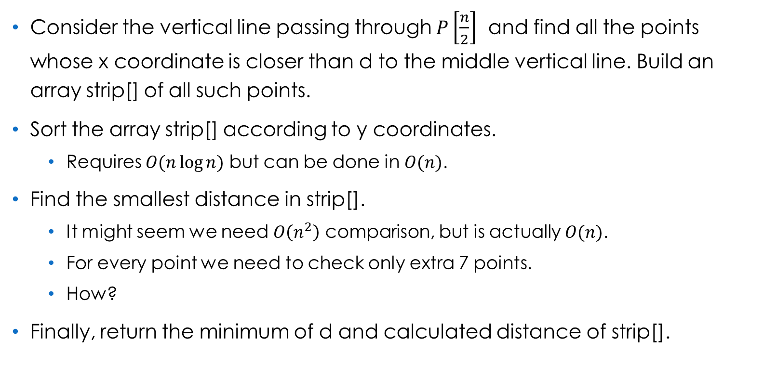
Closest Pair of Points

Slide 20
References
Computer Algorithms – Ellis Horowitz, Sartaj Sahni, Sanguthevar Rajasekaran.
Closest Pair of Points using Divide and Conquer algorithm - GeeksforGeeks

Slide 21
Thank You.

